Slide 1
How to reach the training room
using ZOOM

Slide 2
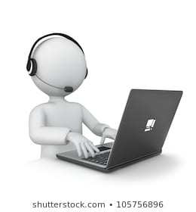
Joining the training
Visit the link provided in the email
Ex:https://zoom.us/j/650662545
The link will take you directly to the training room

Slide 3
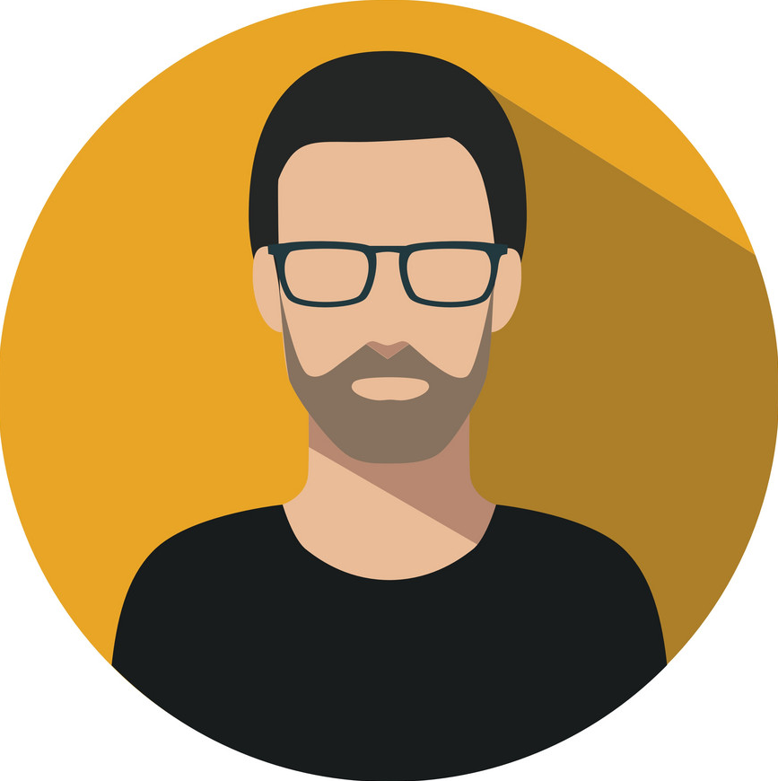
Control Panel
Mute: To mute your microphone
Start Video: To show your face on a video
Invite: to invite somebody else
Participants: All participants in this meeting
Chat: to write something for all or privately
Leave Meeting: to sign out of the meeting

Slide 4
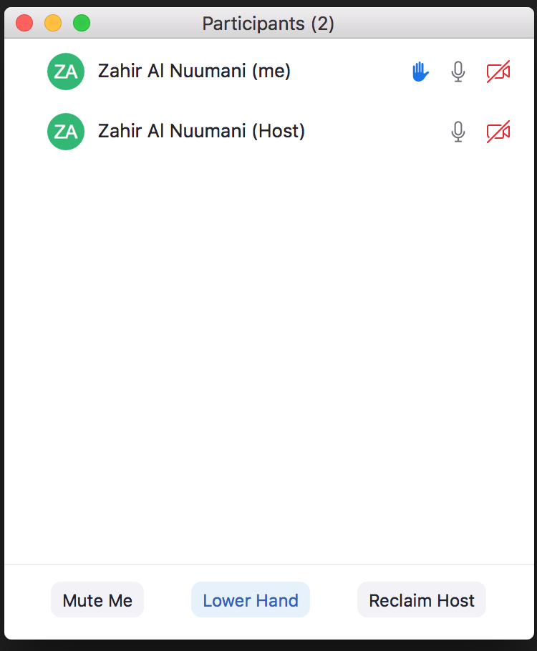
Participants Menu
Host: is the trainer ( from MADA ). He/she is the admin and controls the meeting
Raise hand: click on it, if you want to participate. A blue hand will be shown beside your name, and the trainer will allow you to open your microphone to participate
Lower hand: After participating, click on lower hand, to close it

Slide 5
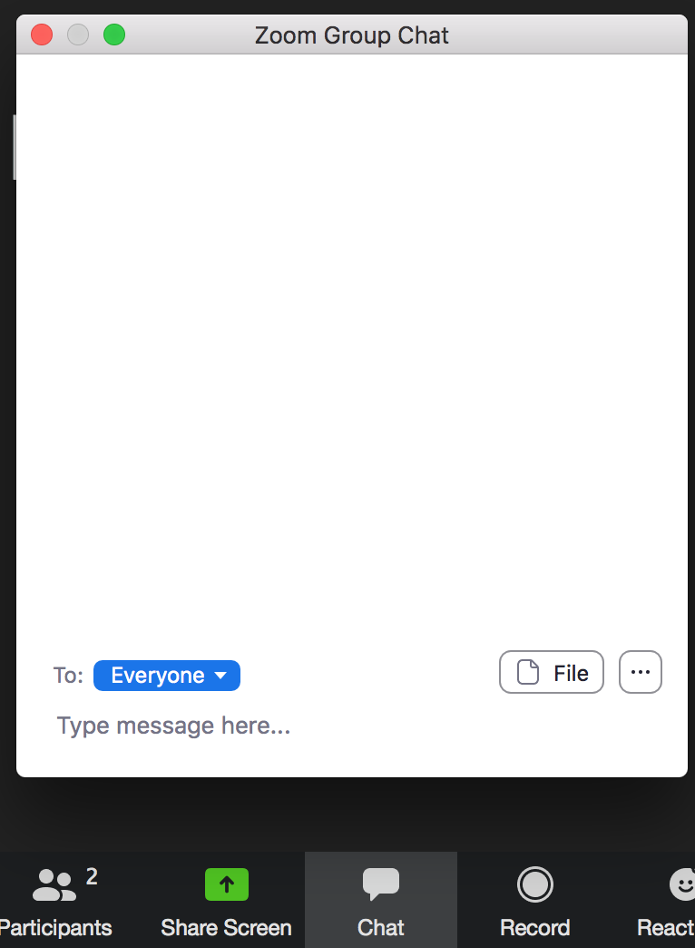
Chat Menu
You can use chat, if you want to use text instead of Microphone.
You can send text to everyone, or privately to one person
It useful, for sharing LINKS, to be accessed by trainees.

